Slide 1
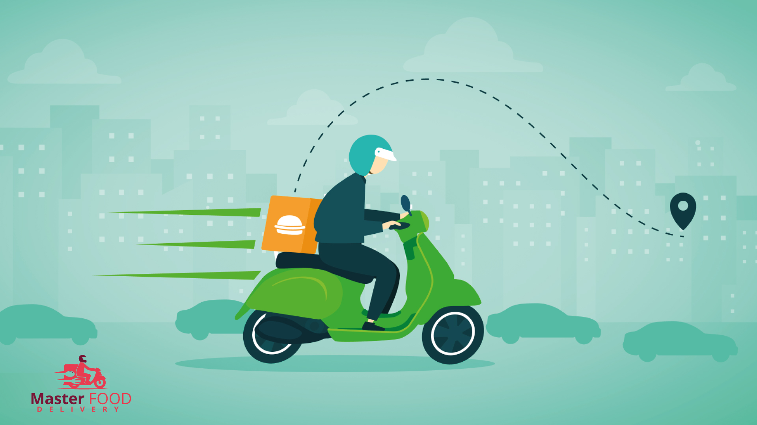

Welcome
Southeast University

Slide 2
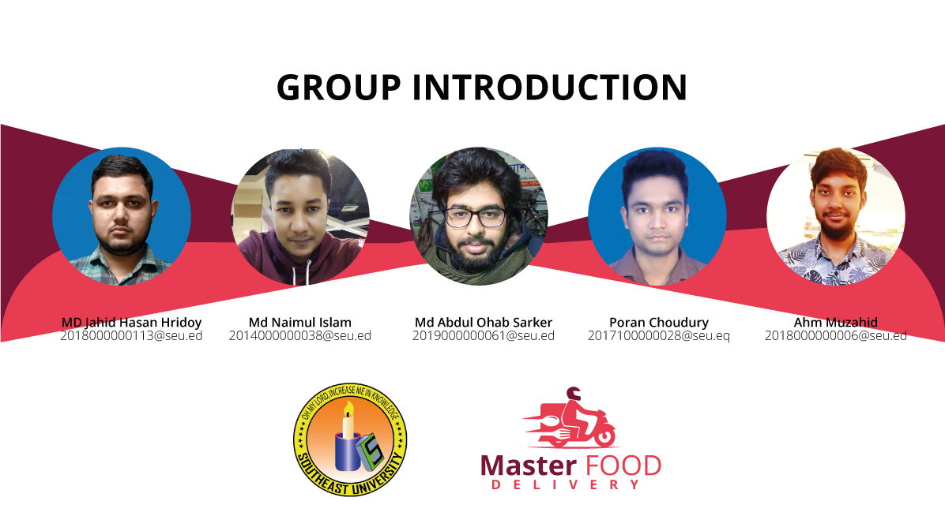

Slide 3
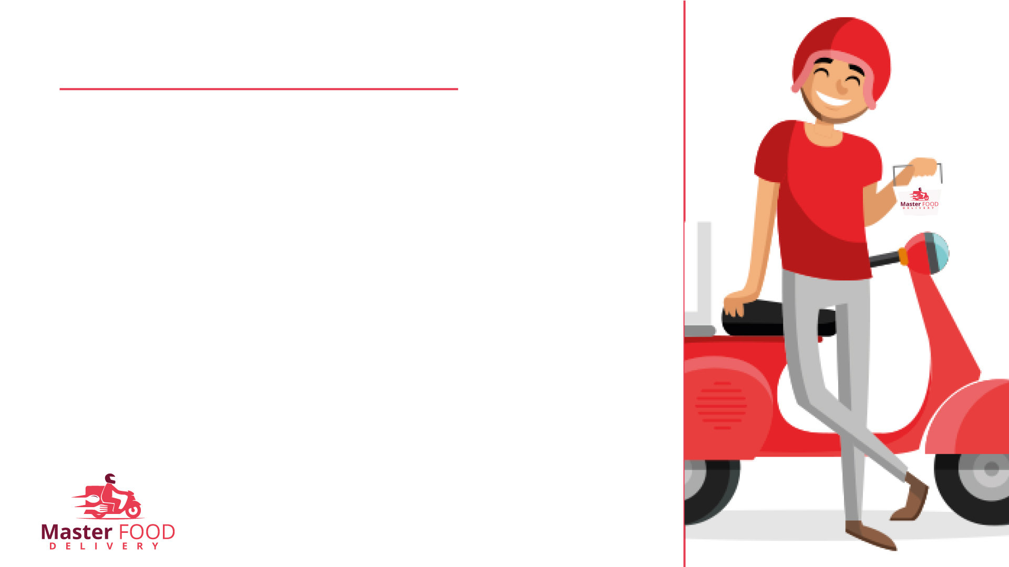
Introduction
Online Food Delivery Management System that we are proposing here, For both the customer and the restaurant, this Project simplifies the ordering procedure. Online based service to order food from a variety of restaurants. Enjoy differently cuisines and flavors delivered to your doorstep by our delivery hero. This System presents an interactive and up-to-date menu with all available options in an easy-to-use manner. Customers can choose one or more items to place an order which will land in the Cart. Customers can view all the order details in the Cart before checking out.

Slide 4
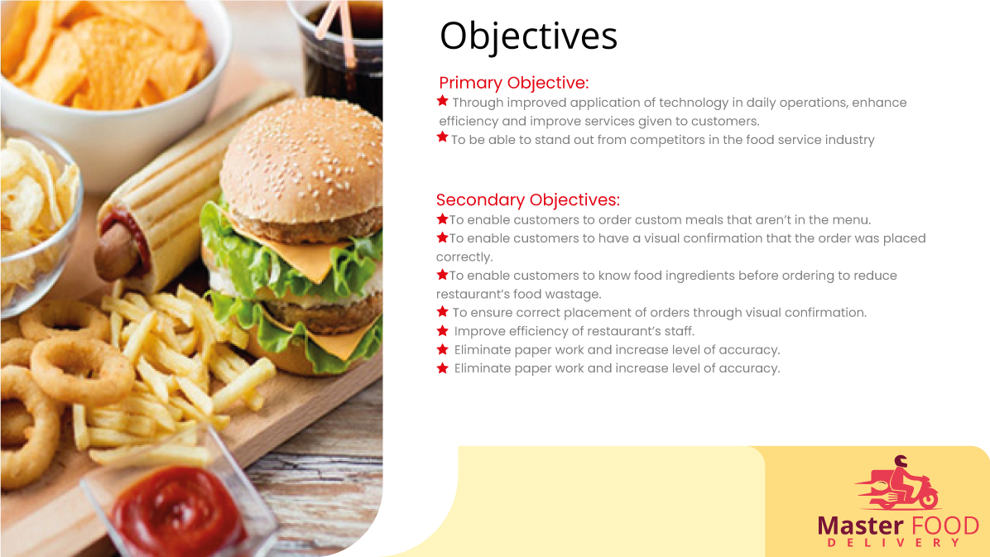

Slide 5
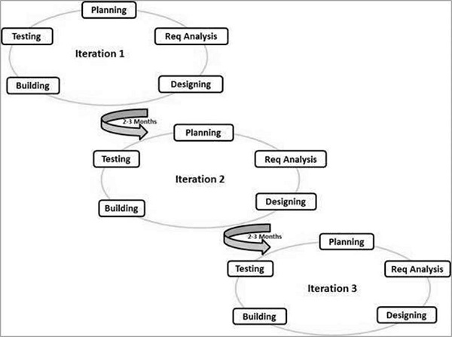
Process Model
Agile
Agile model believes that every project needs to be handled differently and the existing methods need to be tailored to best suit the project requirements. In Agile, the tasks are divided to time boxes (small time frames) to deliver specific features for a release.
Iterative approach is taken and working software build is delivered after each iteration. Each build is incremental in terms of features; the final build holds all the features required by the customer.
The Agile thought process had started early in the software development and started becoming popular with time due to its flexibility and adaptability.
Following are the Agile Manifesto principles −
Individuals and interactions − In Agile development, self-organization and motivation are important, as are interactions like co-location and pair programming.
Working software − Demo working software is considered the best means of communication with the customers to understand their requirements, instead of just depending on documentation.
Customer collaboration − As the requirements cannot be gathered completely in the beginning of the project due to various factors, continuous customer interaction is very important to get proper product requirements.
Responding to change − Agile Development is focused on quick responses to change and continuous development.

Slide 6
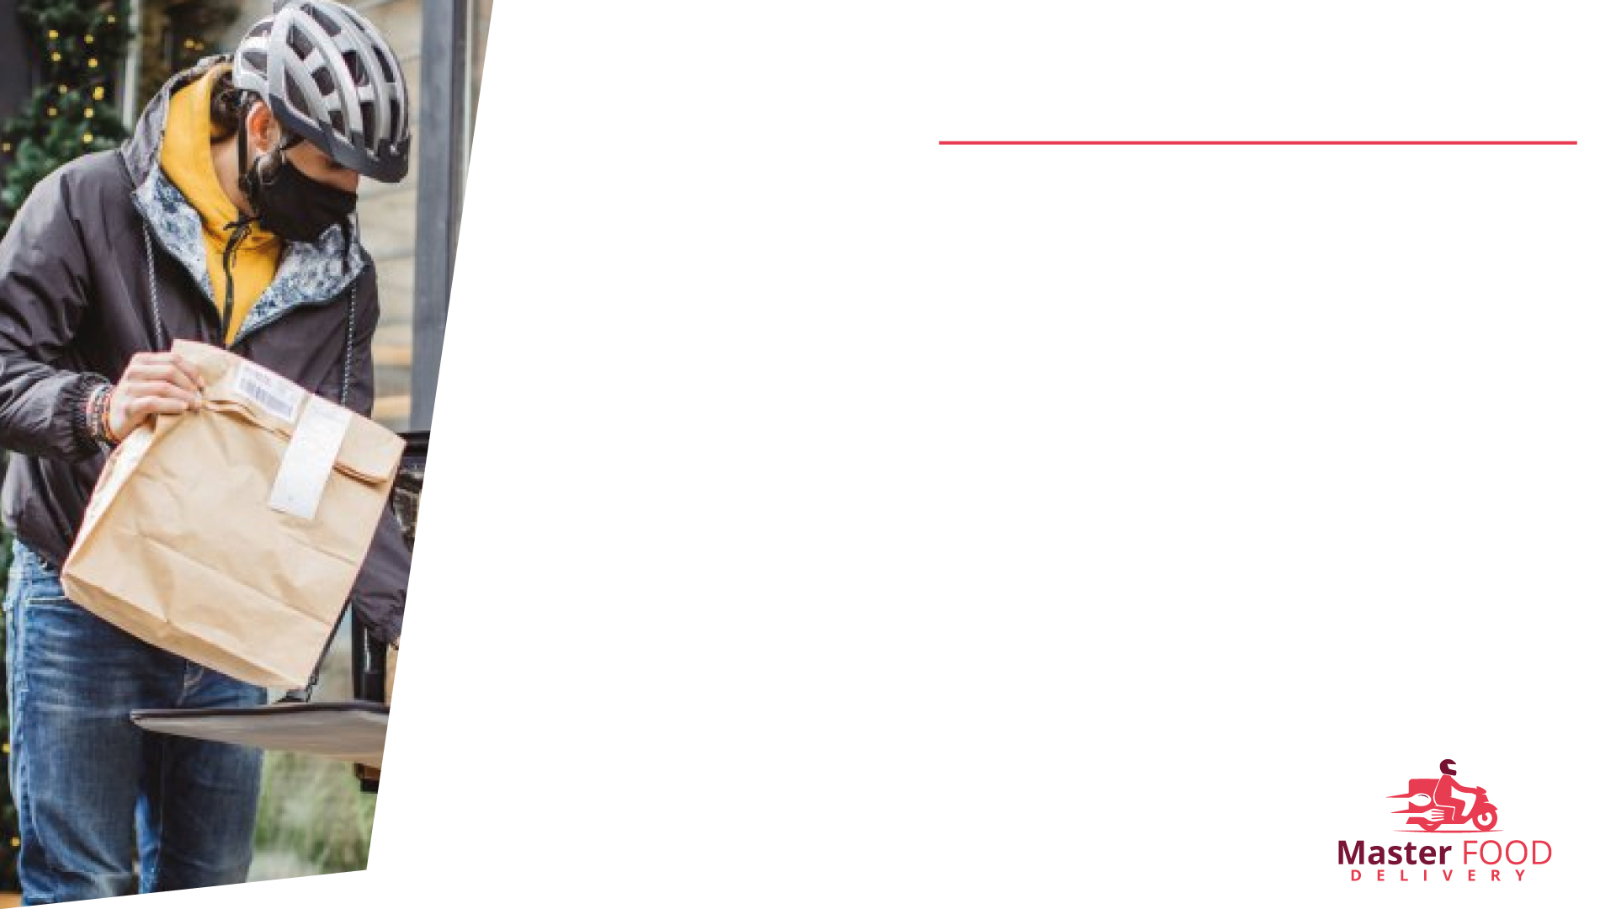
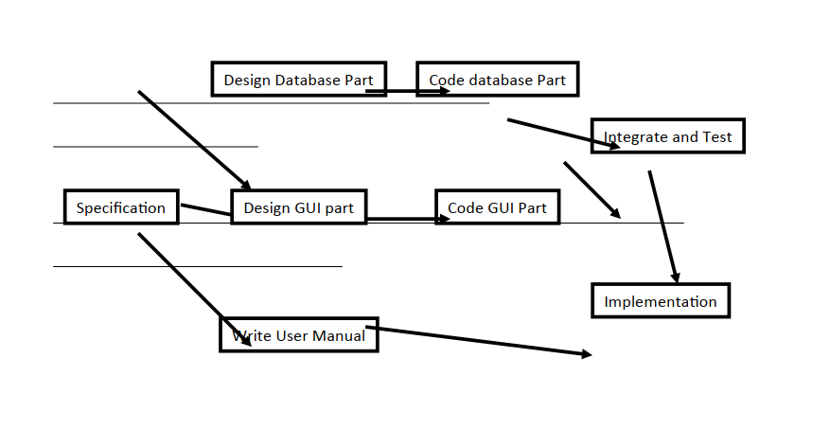
Project Description
Pert / CPM
PERT chart is organized for events, activities or tasks. It is a scheduling device that shows graphically the order of the tasks to be performed. It enables the calculation of the critical path. The time and cost associated along a path is calculated and the path requires the greatest amount of elapsed time in critical path.
Brief description of the project

Slide 7
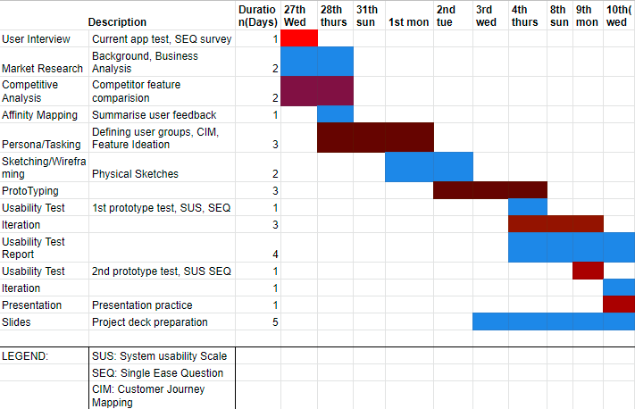
Gannt Chart/time Chart
It is also known as Bar chart is used exclusively for scheduling purpose. It is a project controlling technique. It is used for scheduling. Budgeting and resourcing planning. A Gantt is a bar chart with each bar representing activity. The bars are drawn against a time line. The length of time planned for the activity. The Gantt chart in the figure shows the Gray parts is slack time that is the latest by which a task has been finished
Notes:
May require more than one slide

Slide 8
Resource requirements:
For Restaurant Listing: Github API, FourSquare API.
For Payment: Square API, Braintree, Stripe, PayPal.
To Find user Location: Core Location Framework, Google Places API.
To Find Directions: Google Maps, MapKit.
For Cloud: AWS, Azure.
For Registration: Facebook SDK Login.
For Storage: Amazon Cloud Storage.
For Analytics: Google Analytics.

Slide 9
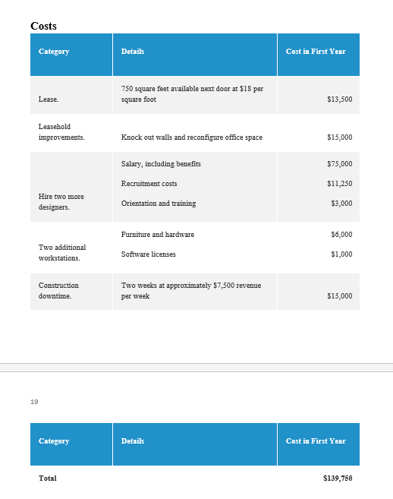
Estimation

Slide 10
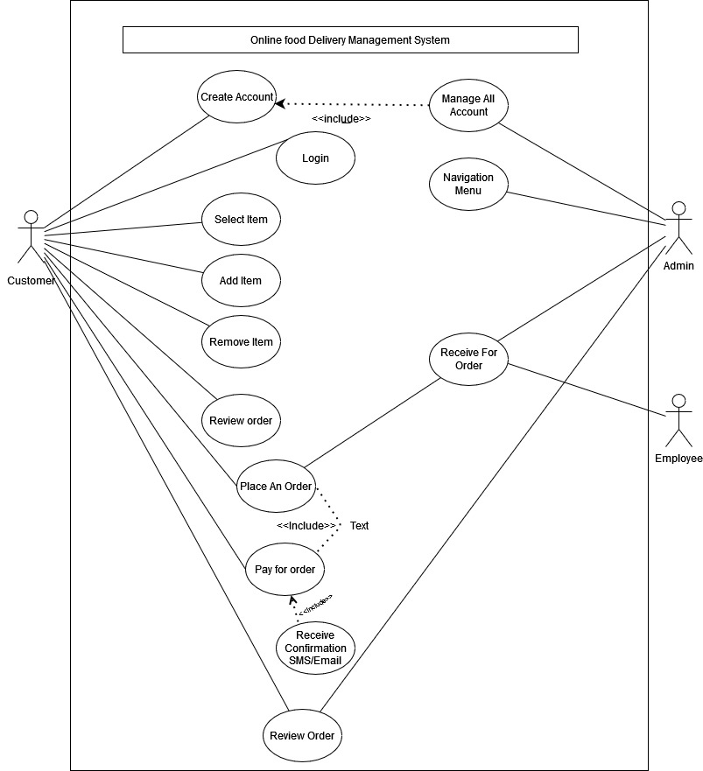
Use Case Diagram
Online Food delivery management system:
use case diagram describing the actors and the activities involved in the proposed solution. The use case begins once the user starts the application. The system will display a login screen. The users enter their credentials by input their email and password. The system will verify the information and lead to the ordering platform. The customer places the food /drink order and the system automatically calculates the total amount. The customer chooses whether they want to eat from the restaurant or takeaway the meal.

Slide 11
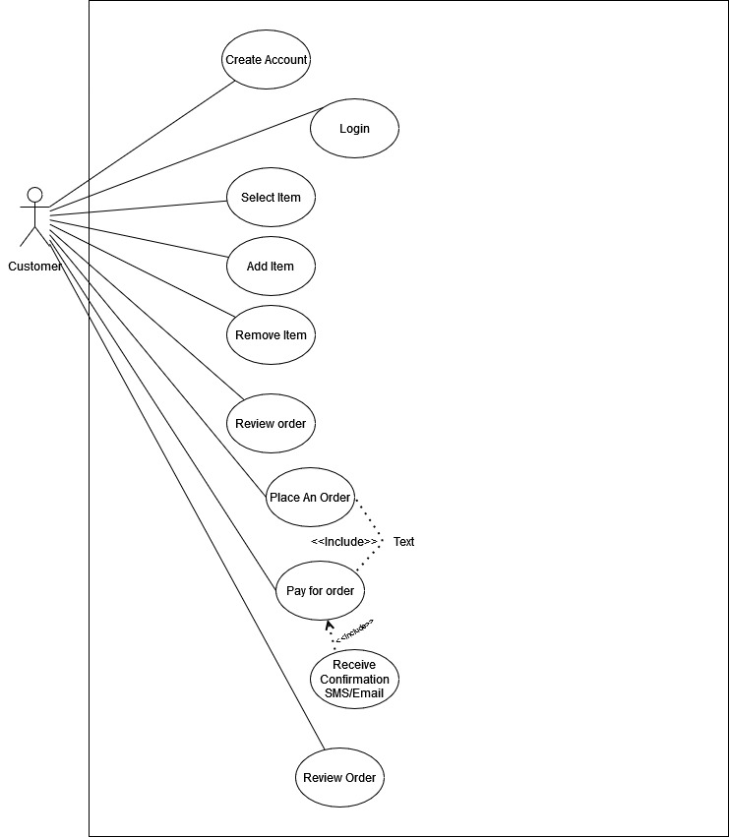
Customer Use case diagram:

Slide 12
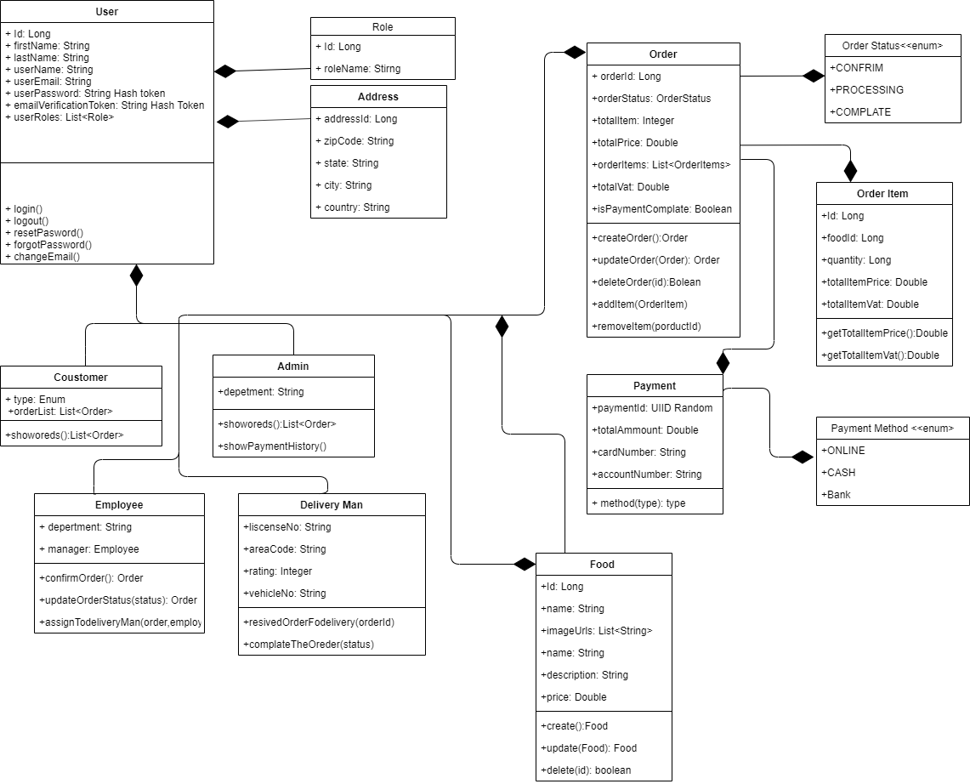
Class diagram

Slide 13
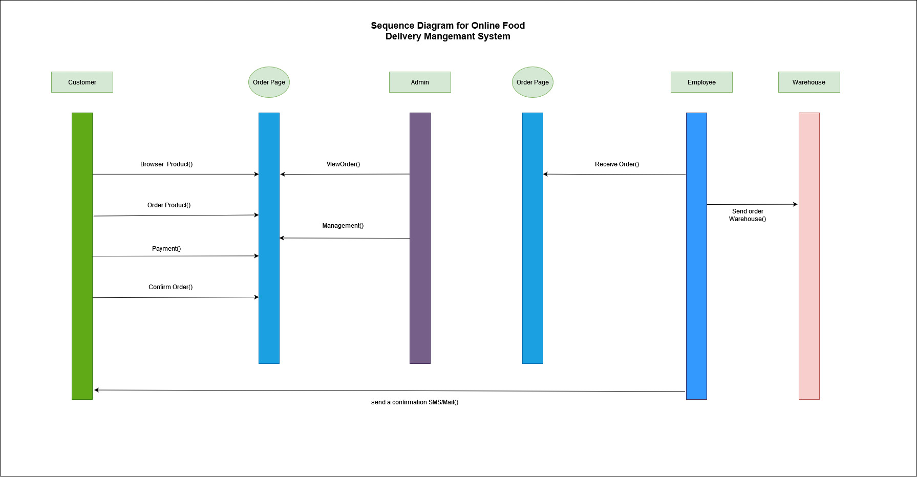
Sequence Diagram
This System Login Sequence Diagram, which shows how admins may access their accounts using their credentials. User may control all operations on Category, Order, Delivery, Food Item, and Customer after logging in. All pages, including Delivery, Food Item, and Customer, are secure, and users may only access them after logging in. The diagram below demonstrates how a Food Ordering System's login page works. The different items on the Food Item, Category, Order, Delivery, and Customer pages interact with one another during the sequence, and users will be unable to access this page without first proving their identification.

Slide 14
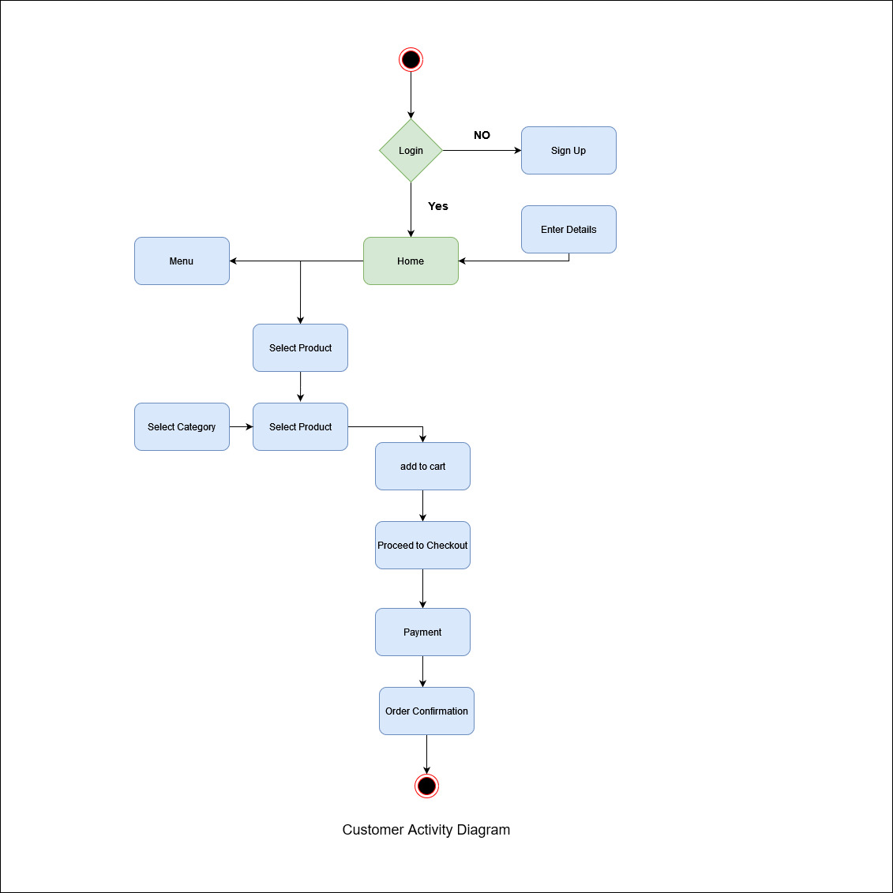
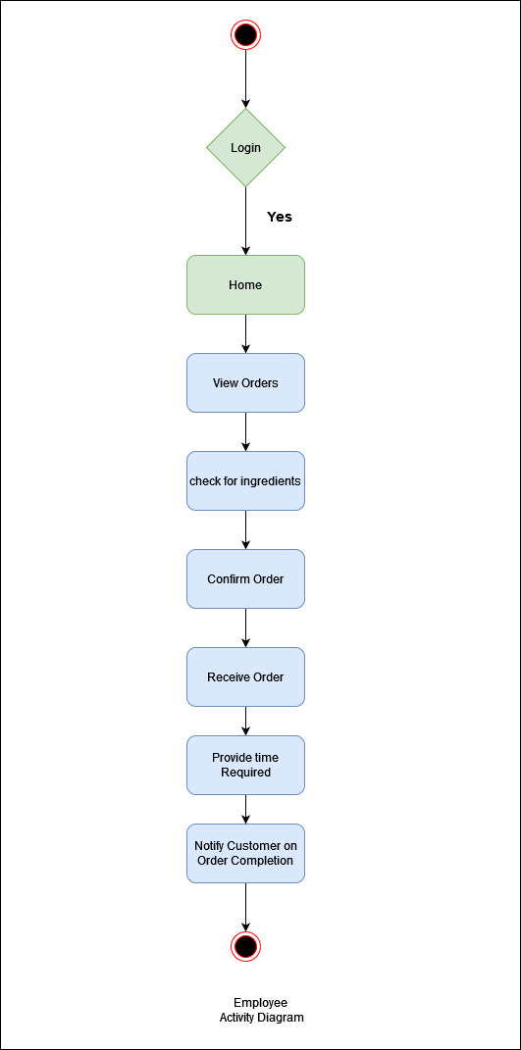
Activity Diagram Customer Activity Diagram

Slide 15
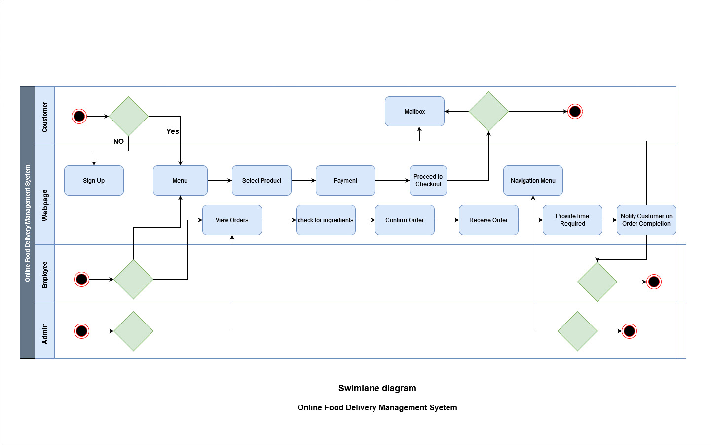
Swim lane diagram Online Food Delivery Management System:
A Swimland activity diagram groups the activities into swim lanes columns that contain all of the activities which fit into the category represented by that Swimland. Swim lanes can represent many categories of information such as actors which perform the activities, the stage of the process in which the activity takes place, or whatever else the creator of the document feels should be emphasized and communicated by the swim lane diagram. The term swim lane was adopted due to the visual similarity between the horizontal rows of the diagram to that of the swim lanes found within a swimming pool.

Slide 16
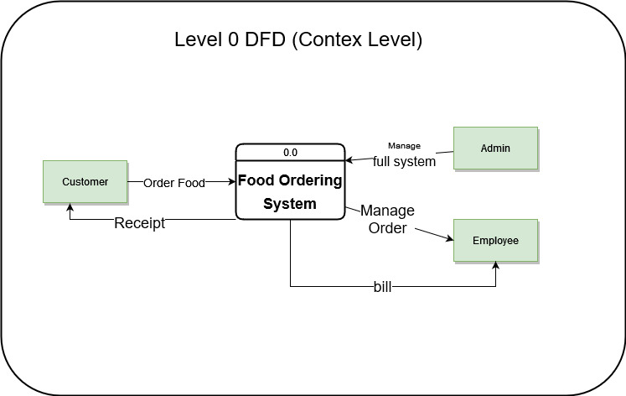
Data Flow Diagram
DFD diagram level 0:
At this level, the Input and Output of the system are shown. The system is designed and established across the world with input and output at this level.

Slide 17
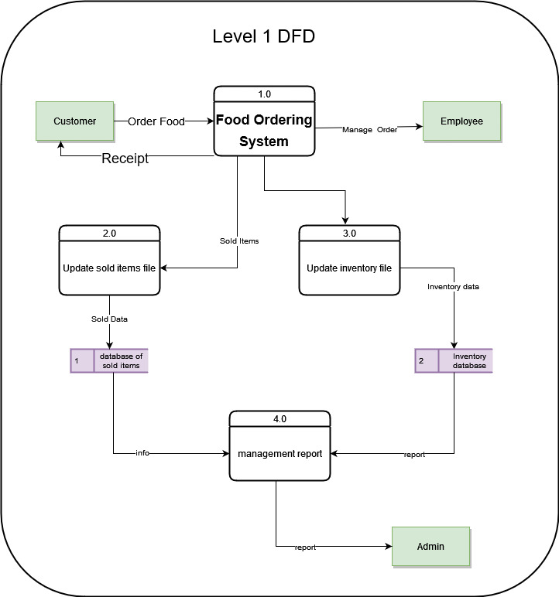
Data Flow Diagram
DFD diagram level 1:
For processing the order, process 1.0 is responsible. For food, the housekeeping activities involved are represented by processes 2.0, 3.0, and 4.0. The detailed information about daily sold items should be available to create and report management and the list of items that are available ‘in-stock’ should be kept by maintaining the inventory at the same time.

Slide 18
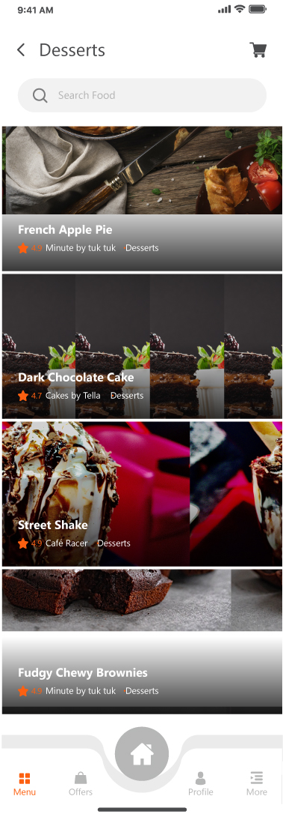
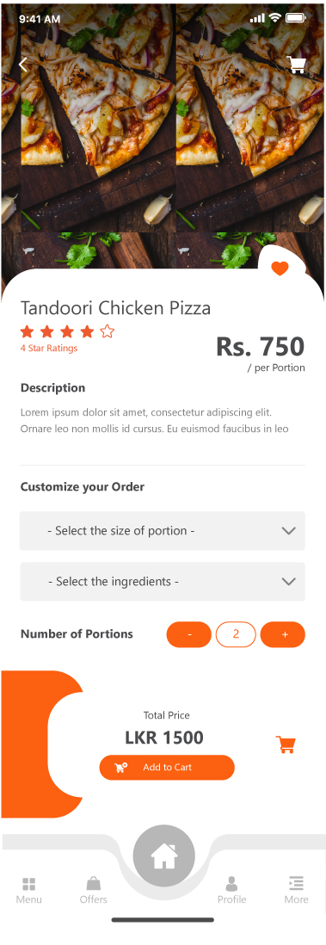
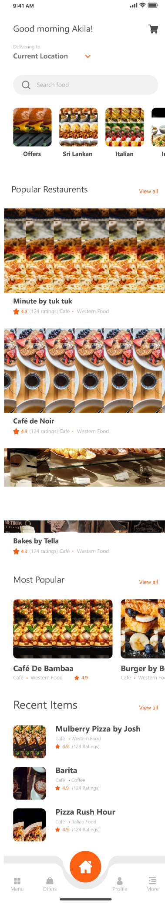
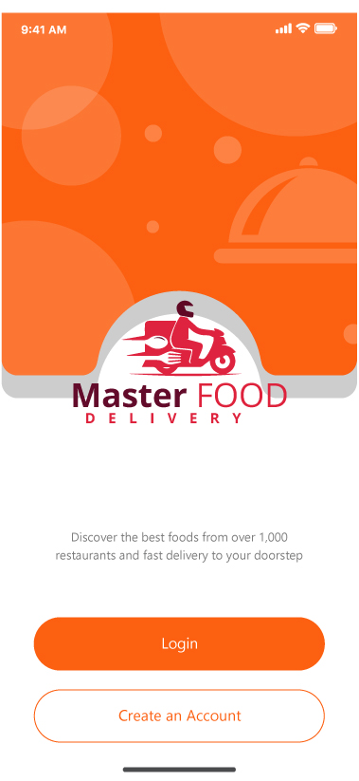
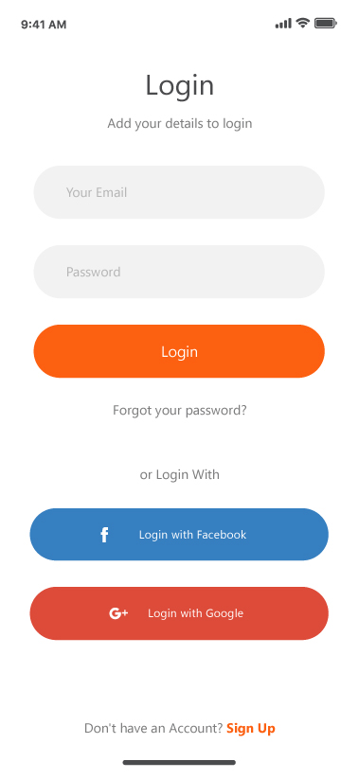
UI/UX
Notes:
May require more than one slide

Slide 19
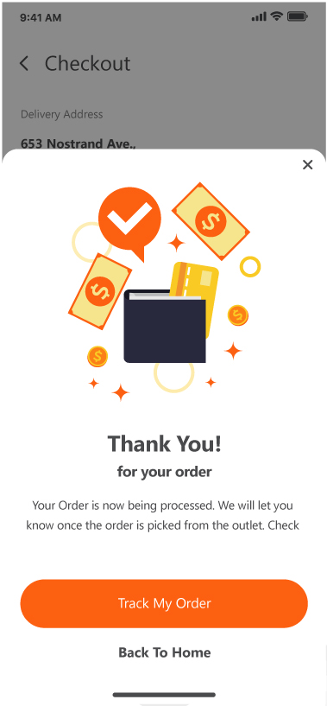
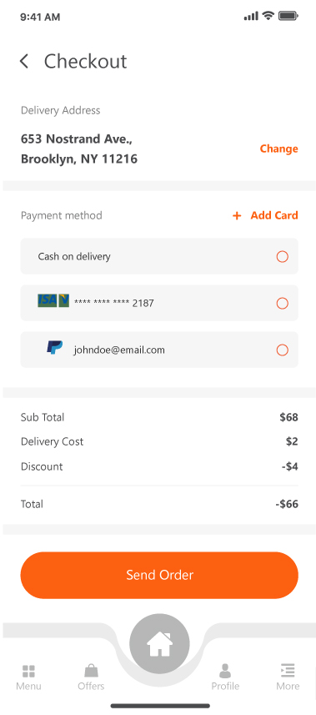
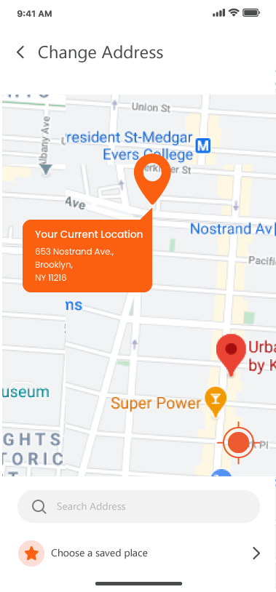
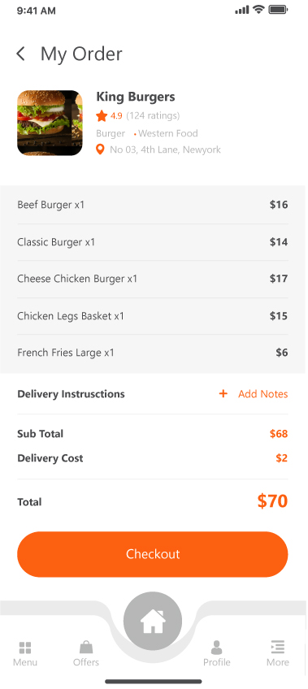
UI/UX
Notes:
May require more than one slide

Slide 20
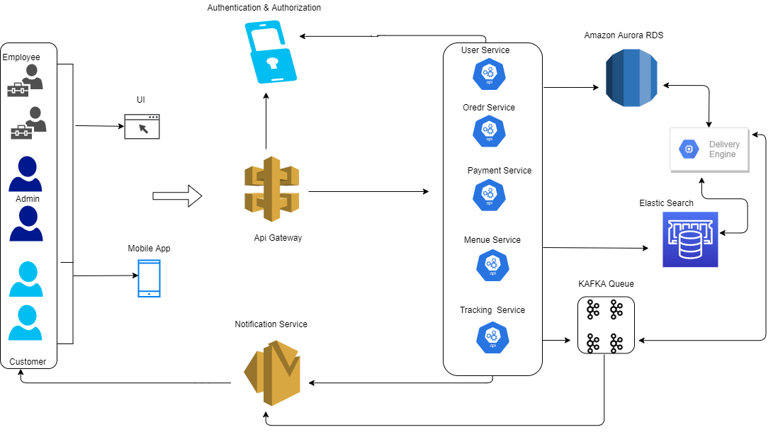
Architecture Flow Diagram
Online Food Delivery Management System Architecture Flow Diagram

Slide 21
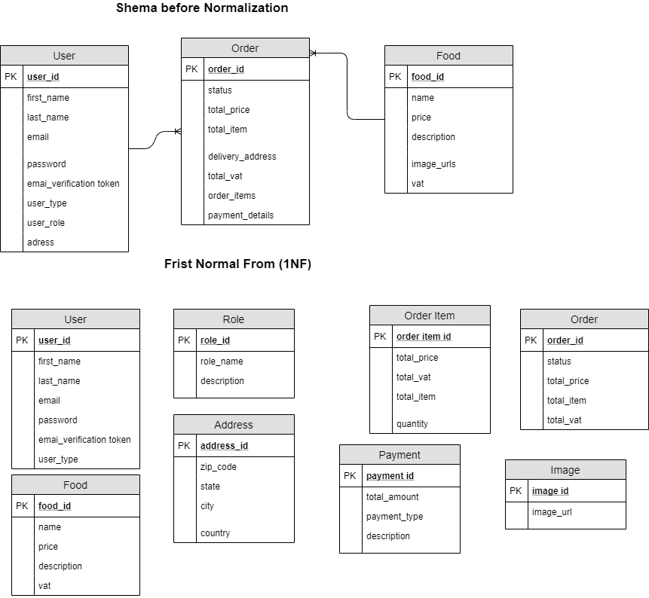
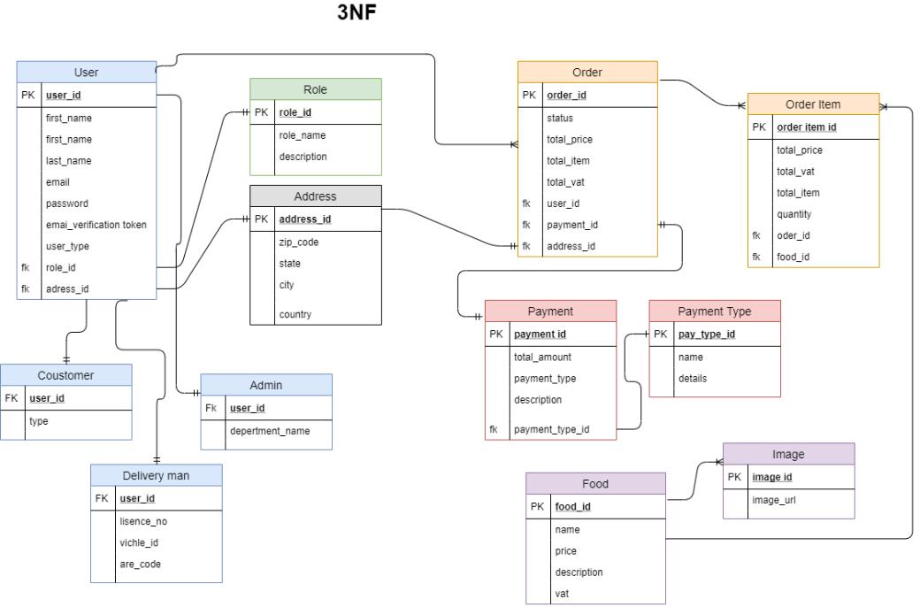
Schema Diagram

Slide 22
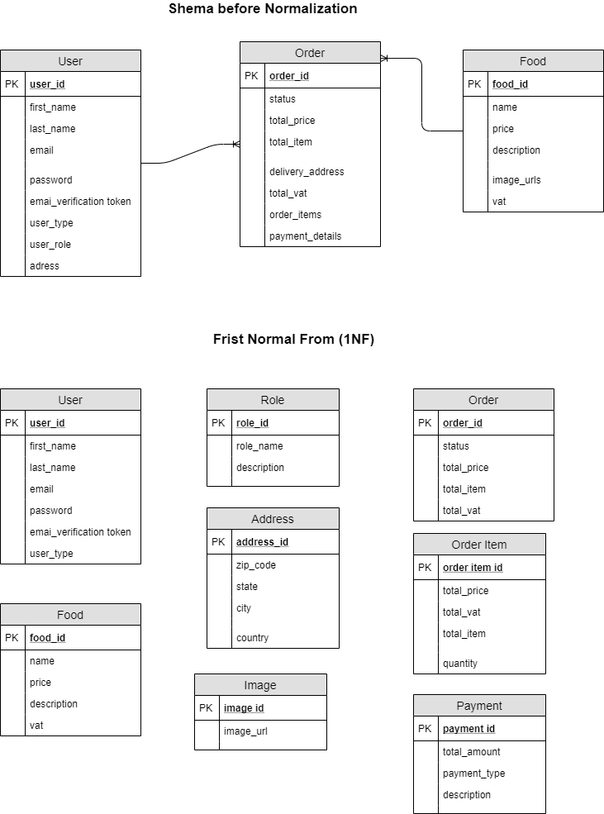
Normalization

Slide 23
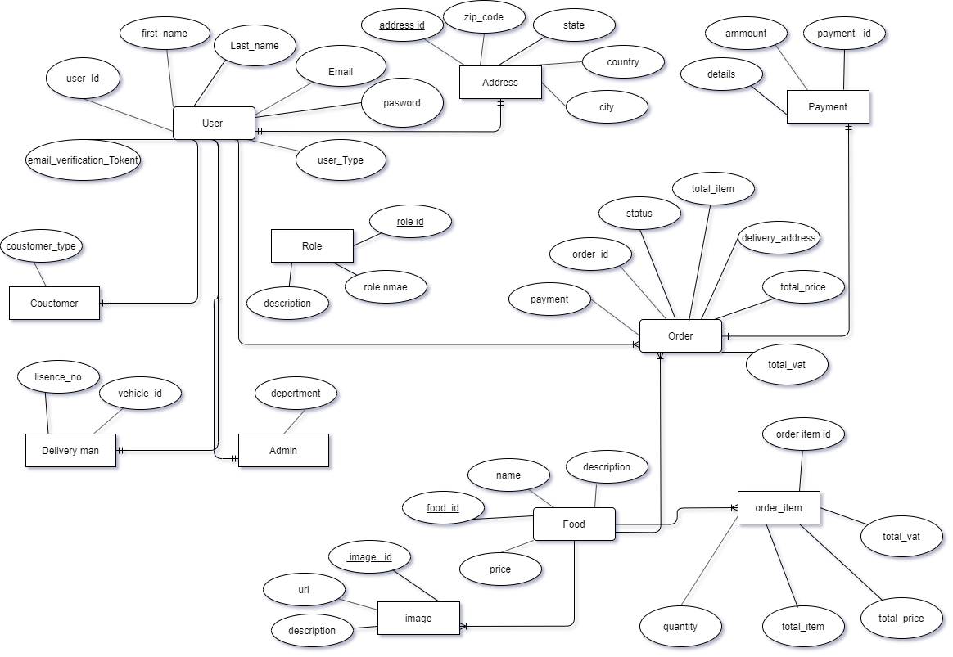
ERD After Normalization

Slide 24
Learning Experience
The project took a long time to complete.
It was attempted to incorporate as many features as feasible within the time constraints.
The Functional Requirements were met satisfactorily.
Some of the system's non-functional requirements have not been implemented.
These requirements are the most important and reflect the most important qualities.
Due to time constraints, some needs are not implemented. However, because they are lower priority features, their loss would not cause substantial operational concerns.
In the future, these functionalities may be introduced.

Slide 25
Conclusion
After a decade of technological growth and invention, people are able to perform their tasks more conveniently and efficiently. Many other industries have employed management systems to help their businesses thrive for a long time, and the food and beverage industry is following suit. By completely employing the system at the end of this project, the system will be able to minimize and replace human manpower tasks, reduce transaction time, and provide reports for further management purposes.
On the other side, modern technology makes the criterion for portability simple to meet. As a result, portability has become one of the factors that must be considered throughout the creation of a system. Because mobility provides a number of advantages to users while using the system, such as convenience, accessibility, and ease of communication, among others. As a result, mobility has had such an impact on society that everyone now prefers to do their tasks using a portable device.

Slide 26
